Slide 1
WHY SELL
HUMANA Mississippi 2018

Slide 2
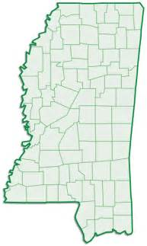
We Have a Place for YOU in 2018
Notes:
Same

Slide 3
Mississippi Key Points – 2018
Humana Call Center - RPPO to LPPO Strategy
Seminar Pilot Market
LIS Opportunity - - 60% on Medicare have LIS
No Referrals required on HMO in MS
Reciprocity across HMO products

Slide 4
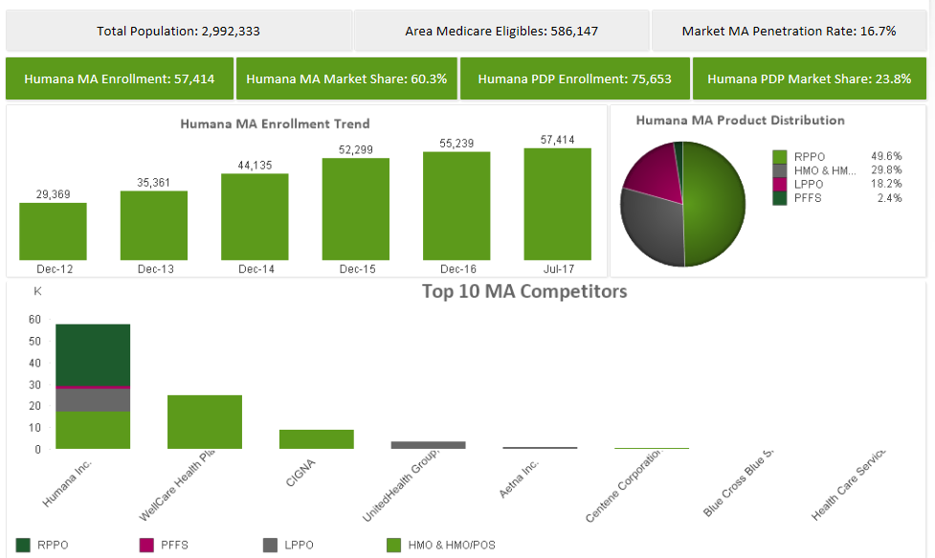
Statewide Dashboard

Slide 5
MISSISSIPPI Highlights: Statewide
Local PPO
Regional PPO
Regional PPO
Regional PPO
MS LPPO
H5216-136
$47 Premium
MOOP: $6700/$10,000 (OON)
PCP /SPEC: $10/$45
Inpatient: $275 Days 1-7
Outpatient: $275
OTC: $25 Quarter
Dental: YES
Vision: YES
Hearing: YES
Misc: Well Dine
Rx Included or No Rx: YES
$400 Deductible Tiers 4/5
Serving Counties: Amite, Carroll, Clarke, Coahoma, Greene, Holmes, Humphreys, Jefferson, Jefferson Davis, Kemper, Lauderdale, Lawrence, Monroe, Montgomery, Neshoba, Newton, Simpson, Smith, Tallahatchie, Tishomingo, Walthall, Wayne
MA ONLY
R0110-001
$0 Premium
MOOP: $6700/$10,000 (OON)
PCP / SPEC: $10/$35
Inpatient: $195 Days 1-6
Outpatient: $195
OTC: $30 Quarter
Dental: YES
Vision: YES
Hearing: YES
Misc: Well Dine
Rx Included or No Rx: NO
Serving Counties: Entire state of MS
RPPO
R0110-002
$55 Premium
MOOP: $6700/$10,000 (OON)
PCP /SPEC: $15/$50
Inpatient: $275 Days 1-7
Outpatient: $275
OTC: $25 Quarter
Dental: NO
Vision: YES
Hearing: YES
Misc: Well Dine
Rx Included or No Rx: YES
$300 Deductible Tiers 3/4/5
Serving Counties: Entire State of MS
RPPO Passive
R0110-003
$89 Premium
MOOP: $6700/$10,000 (OON)
PCP /SPEC: $15/$50
Inpatient: $275 Days 1-7
Outpatient: $275
OTC: $25 Quarter
Dental: YES
Vision: YES
Hearing: YES
Misc: Well Dine
Rx Included or No Rx: YES
$400 Deductible Tiers 4/5
Serving Counties: Entire State of MS

Slide 6
Mississippi Highlights: Statewide
Benefit Highlights
$0 Premium MA ONLY Plan – great for Veteran Population that use VA
Over the Counter (OTC) Benefits
Silver Sneakers – free fitness and gym membership
$0 Copay Rx Benefit - Tier 1 & 2 Rx, if member uses Humana Mail order for 90 day supply
Network Highlights
Large PPO Network across the state of MS
Can use Humana MAPD providers across the nation
Strong Relationships with Providers
Competitive Advantages
57,000 Members Strong and Growing - #1 MAPD Carrier in the state of MS
Strong Brand Recognition In Market
Local Market office and Support Team in Biloxi and Ridgeland
Customer Service Representative in Ridgeland office and Customer Service Kiosk in Biloxi

Slide 7
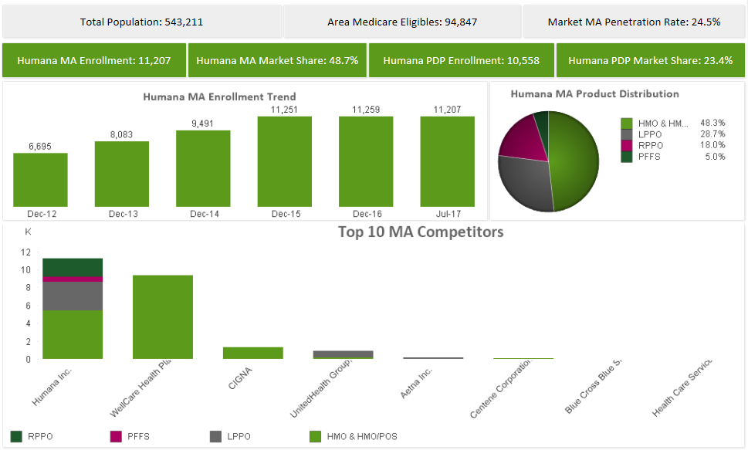
Jackson Metro

Slide 8
MISSISSIPPI Highlights: Jackson Metro
HMO
Regional PPO
SNP
Local PPO
HMO
HMO
HMO
Local PPO
Jackson HMO
H1036-151
$26 Premium
MOOP: $6700
PCP /SPEC: $0/$40
Inpatient: $295 Days 1-6
Outpatient: $295
OTC: $45 Quarter
Dental: YES
Vision: YES
Hearing: NO
Rx Included or No Rx: YES
$400 Deductible Tiers 4/5
Serving Counties : Attala, Copiah, Hinds, Madison, Rankin
MS Dual SNP
H1036-222
$0 Premium
MOOP: $6700
PCP /SPEC: $0/$0
Inpatient: $0
Outpatient: $0
OTC: $50 Month
Dental: YES
Vision: YES
Hearing: YES
Misc: Transportation, Lifeline
Rx Included or No Rx: YES
Serving Counties : Attala, Copiah, Hinds, Madison, Rankin, Desoto, Harrison, Hancock, Pearl River, Jackson
Part B Giveback
H6622-047
$0 Premium
($40 monthly Part B Giveback)
MOOP: $6700
PCP / SPEC: 20%
Inpatient: $550 Days 1-3
Outpatient: 20%
OTC: $45 Quarter
Dental: YES
Vision: YES
Hearing: NO
Misc: Must pay Part B Deductible
Rx Included or No Rx: YES
$375 Deductible Tiers 3/4/5
Serving Counties : Attala, Copiah, Hinds, Madison, Rankin
Jackson LPPO
H5216-067
$47 Premium
MOOP: $6700/$10,000 (OON)
PCP /SPEC: $10/$45
Inpatient: $295 Days 1-6
Outpatient: $295
OTC: $30 Quarter
Dental: YES
Vision: YES
Hearing: YES
Rx Included or No Rx: YES
$400 Deductible Tiers 4/5
Serving Counties : Attala, Claiborne, Copiah, Hinds, Leake, Madison, Rankin, Scott, Wilkinson, Yazoo
Plan Name
$-- Premium
MOOP:
PCP Pref/ Non Pref/SPEC:
Inpatient:
Rx Included or No Rx:
Contract/PBP: H0000-000
Group ID: To be provided between late Sept. & 10/1
BSN: To be provided between late Sept. & 10/1
Serving Counties : Area Name, Area Name, Area Name, Area Name, & Area Name
Regional PPO
Plan Name
$-- Premium
Deductible & Applicable Tiers:
Mail Order Rx Tier Copay:
Preferred Rx Tier Copay:
Standard Rx Tier Copay:
Contract/PBP: H0000-000
Group ID: To be provided between late Sept. & 10/1
BSN: To be provided between late Sept. & 10/1
Serving Counties : Area Name, Area Name, Area Name, Area Name, & Area Name
PDP
PFFS
Medicare Supplement
PDP

Slide 9
Mississippi Highlights: Jackson Metro
Benefit Highlights
New $0 Premium $40 Part B Giveback Plan
HMO plans include various levels of Dental, Hearing, & Vision benefits
4 star plans
No referrals required to see specialist
Over the Counter (OTC) Benefits on all products
Transportation benefit on Dual SNP Plan
Silver Sneakers – free fitness and gym membership
$0 Tier 1 & 2 Rx Benefits if member uses Humana Mail order for 90 day supply
Network Highlights
HMO Network includes St. Dominic and Baptist Health Systems – all hospitals and providers
PPO Network includes St. Dominic, Baptist Health Systems and Merit facilities
Strong Relationships with Providers
Competitive Advantages
57,000 Members Strong and Growing - #1 MAPD Carrier in the state of MS
Strong Brand Recognition In Market
Local Market office and Support Team in Ridgeland
Year Round Selling opportunities: Dual SNP Plan

Slide 10
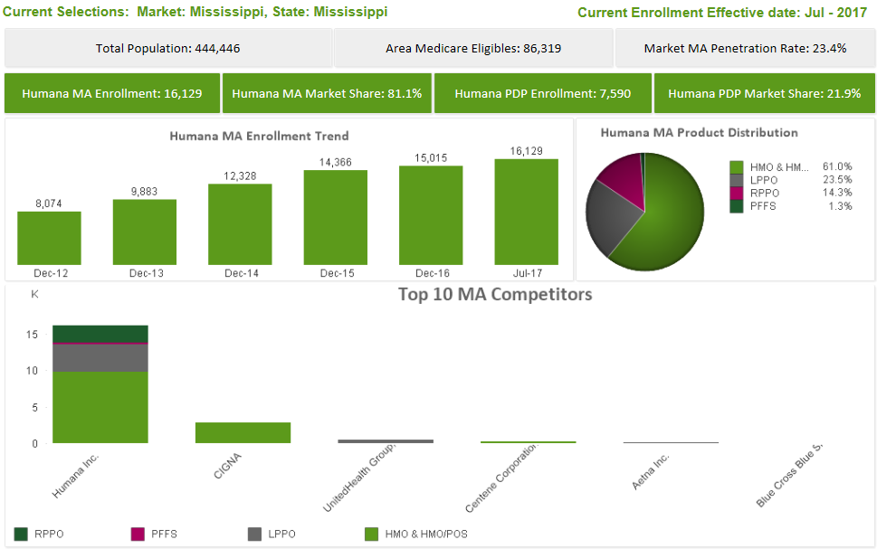
MS Gulf Coast

Slide 11
MISSISSIPPI Highlights: MS Gulf Coast
HMO
SNP
Local PPO
HMO
HMO
Local PPO
Gulf Coast HMO
H1036-171
$25 Premium
MOOP: $6700
PCP /SPEC: $10/$45
Inpatient: $295 Days 1-6
Outpatient: $295
OTC: $30 Quarter
Dental: NO
Vision: YES
Hearing: YES
Rx Included or No Rx: YES
$200 Deductible Tiers 3/4/5
Serving Counties : Hancock, Harrison, Pearl River and Jackson
MS Dual SNP
H1036-222
$0 Premium
MOOP: $6700
PCP /SPEC: $0/$0
Inpatient: $0
Outpatient: $0
OTC: $50 Month
Dental: YES
Vision: YES
Hearing: YES
Misc: Transportation, Lifeline
Rx Included or No Rx: YES
Serving Counties : Attala, Copiah, Hinds, Madison, Rankin, Desoto, Harrison, Hancock, Pearl River, Jackson
Gulf Coast LPPO
H5216-067
$47 Premium
MOOP: $6700/$10,000 (OON)
PCP /SPEC: $10/$45
Inpatient: $275 Days 1-7
Outpatient: $275
OTC: $25 Quarter
Dental: YES
Vision: NO
Hearing: YES
Misc: Welldine
Rx Included or No Rx: YES
$400 Deductible Tiers 4/5
Serving Counties : Harrison, Hancock, Pearl River, Jackson, George, Stone
Regional PPO
PDP
PFFS
Medicare Supplement

Slide 12
Mississippi Highlights: MS Gulf Coast
Benefit Highlights
$0 Premium DE-SNP / $25 Premium HMO / $47 Premium LPPO
HMO Plan includes various levels of Dental, Hearing, & Vision benefits
4 star plans
No referrals Required to see specialist
Can use HMO providers in Mobile and LA Parishes
Over the Counter (OTC) Benefits on all products
Transportation benefits on Dual SNP Plan
Silver Sneakers – free fitness and gym membership
$0 Tier 1 & 2 Rx Benefits if member uses Humana Mail order for 90 day supply
Network Highlights
HMO Network includes Gulfport Memorial, Singing River and Hancock Medical
PPO Network includes Gulfport Memorial, Singing River, Hancock Medical and Merit Facilities
Strong Relationships with Providers
Competitive Advantages
57,000 Members Strong and Growing - #1 MAPD Carrier in the state of MS
Strong Brand Recognition In Market
Local Market office and Support Team in Biloxi along with a Customer Service Kiosk
Year Round Selling opportunities: Dual SNP Plan

Slide 13
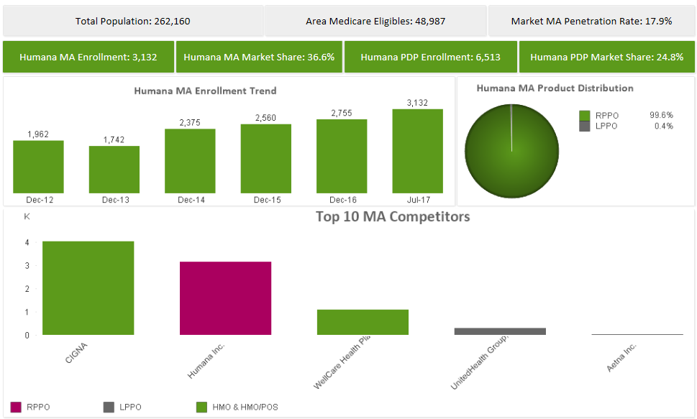
Hattiesburg Area

Slide 14
MISSISSIPPI Highlights: Hattiesburg
HMO
SNP
Local PPO
HMO
HMO
Hattiesburg HMO
H6622-047
$15 Premium
MOOP: $6700
PCP /SPEC: $0/$40
Inpatient: $270 Days 1-7
Outpatient: $270
OTC: $20 Quarter
Dental: YES
Vision: YES
Hearing: YES
Rx Included or No Rx: YES
$300 Tiers 3/4/5
Serving Counties : Covington, Forrest, Jones, Lamar, Marion, Perry
Hattiesburg Dual SNP
H6622-048
$0 Premium
MOOP: $6700
PCP /SPEC: $0
Inpatient: $0
Outpatient: $0
OTC: $40 Month
Dental: YES
Vision: YES
Hearing: YES
Misc: Transportation, Lifeline
Rx Included or No Rx: YES
Serving Counties : Covington, Forrest, Jones, Lamar, Marion, Perry
Regional PPO
PDP
PFFS
Medicare Supplement

Slide 15
Mississippi Highlights: Hattiesburg
Benefit Highlights
New HMO products for 2018 - $ 0 Premium DE- SNP / $ 15 Premium HMO
Plans include Dental, Hearing, & Vision benefits
4 star plans
No referral needed to see a specialist
Over the Counter (OTC) Benefits on all plans
Transportation benefits on Dual SNP Plan
Silver Sneakers – free fitness and gym membership
$0 Tier 1 & 2 Rx Benefits if member uses Humana Mail order for 90 day supply
Network Highlights
Forrest General and Hattiesburg Clinic in HMO Network
Strong Relationships with Providers
Competitive Advantages
57,000 Members Strong and Growing - #1 MAPD Carrier in the state of MS
Strong Brand Recognition In Market
Local Market Support Team
Year Round Selling opportunities: Dual SNP Plan

Slide 16
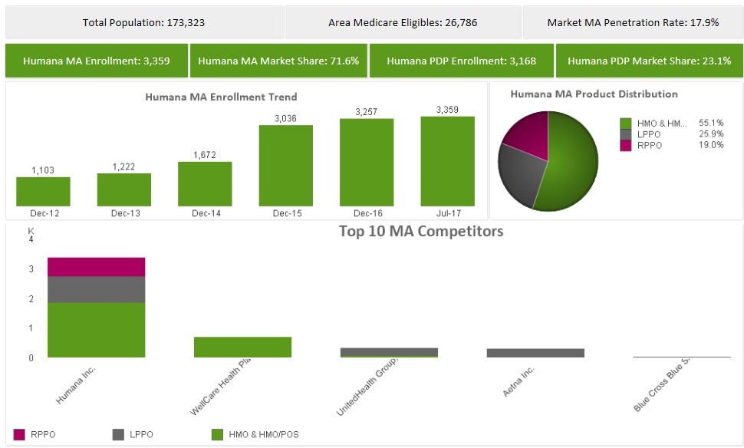
Desoto

Slide 17
MISSISSIPPI Highlights: Desoto
HMO
SNP
Local PPO
HMO
HMO
Local PPO
Desoto HMO
H1036-223
$35 Premium
MOOP: $6700
PCP /SPEC: $0/$40
Inpatient: $250 Days 1-6
Outpatient: $250
OTC: $45 Quarter
Dental: YES
Vision: YES
Hearing: YES
Misc: Welldine
Rx Included or No Rx: YES
$320 Deductible Tiers 4/5
Serving Counties : Desoto
MS Dual SNP
H1036-222
$0 Premium
MOOP: $6700
PCP /SPEC: $0/$0
Inpatient: $0
Outpatient: $0
OTC: $50 Month
Dental: YES
Vision: YES
Hearing: YES
Misc: Transportation, Lifeline
Rx Included or No Rx: YES
Serving Counties : Attala, Copiah, Hinds, Madison, Rankin, Desoto, Harrison, Hancock, Pearl River, Jackson
Memphis LPPO
H5216-093
$61 Premium
MOOP: $6700/$10,000 (OON
PCP /SPEC: $15/$45
Inpatient: $285 Days 1-6
Outpatient: $275
OTC: $25 Quarter
Dental: YES
Vision: YES
Hearing: YES
Rx Included or No Rx: YES
$400 Deductible Tiers 4/5
Serving Counties : Benton, Desoto, Tate, Tunica
Regional PPO
PDP
PFFS
Medicare Supplement

Slide 18
Mississippi Highlights: Desoto
Benefit Highlights
$0 premium DE-SNP / $35 Premium HMO / $61 Premium LPPO
HMO Plans includes Dental, Hearing, & Vision benefits
4 star plans
No Referral needed to see a specialist
Over the Counter (OTC) Benefits on all plans
Transportation benefits on Dual SNP plan
Silver Sneakers – free fitness and gym membership
$0 Tier 1 & 2 Rx Benefits if member uses Humana Mail order for 90 day supply
Network Highlights
HMO Network includes Baptist, Methodist and St. Francis facilities
Strong Relationships with Providers
Competitive Advantages
57,0000 Members Strong and Growing - #1 MAPD Carrier in State of MS
Strong Brand Recognition In Market
Local Market Support Team
Year Round Selling opportunities: Dual SNP Plan
Page 2 of 3

